Slide 1

Green Pace
Security Policy Presentation
Developer: Tristan Ponte

Slide 2

OVERVIEW: DEFENSE IN DEPTH
Green Pace had secure habits but nothing written down so every developer handled security a little differently
This policy standardizes 10 core principles, 10 C++ coding standards, and our encryption and Triple A policies
Each standard is its own layer so if one control fails the next one still protects our critical systems and data
That layering is defense in depth and its the foundation of the whole policy…

Slide 3
THREATS MATRIX
How I placed them
Priority: high severity and likely, Levels 4 and 5
Unlikely: high severity but less likely, Level 3
Likely: probable but low severity, Level 2
Low priority: low severity and unlikely, Level 1
Likely STD-007-CPP STD-010-CPP | Priority STD-002-CPP STD-003-CPP STD-004-CPP STD-005-CPP STD-008-CPP STD-009-CPP
Low priority STD-006-CPP | Unlikely STD-001-CPP

Slide 4
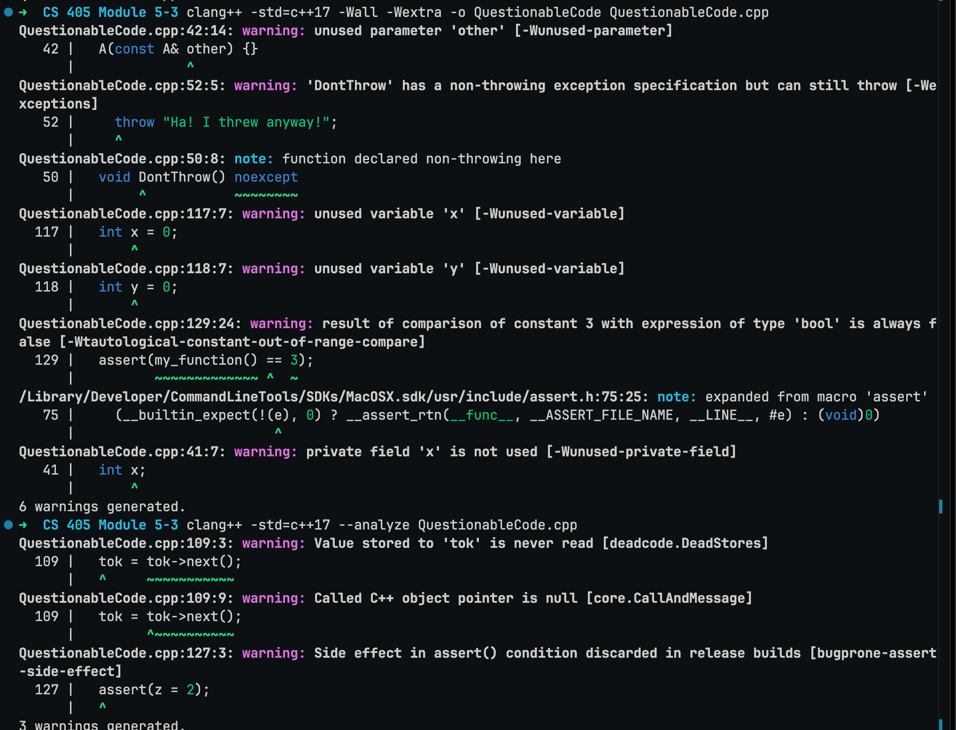
AUTOMATED DETECTION
I ran two automated tools on QuestionableCode.cpp from the module five activity
Clang: compiler warnings plus its static analyzer found 9 issues like the noexcept throw and a null pointer
Cppcheck 2.22: 33 findings including the out of bounds write, dangling pointer and also invalid iterator the compiler missed
Takeaway: neither tool caught the endless recursion or the empty catch so automation backs up code review it doesn't replace it

Slide 5
10 PRINCIPLES
Principle | Coding standards it supports
1. Validate Input Data | STD-001, STD-002, STD-003, STD-004, STD-009
2. Heed Compiler Warnings | STD-001, STD-002, STD-006, STD-009
3. Architect and Design for Security Policies | STD-005, STD-007, STD-008, STD-010
4. Keep It Simple | STD-003, STD-005, STD-008, STD-010
5. Default Deny | STD-004
6. Adhere to the Principle of Least Privilege | STD-004
7. Sanitize Data Sent to Other Systems | STD-004
8. Practice Defense in Depth | STD-003, STD-004, STD-007, STD-010
9. Use Effective Quality Assurance Techniques | STD-002, STD-005, STD-006, STD-007, STD-008, STD-009
10. Adopt a Secure Coding Standard | STD-001, STD-006

Slide 6
CODING STANDARDS
# | Standard | Name | Level
1 | STD-003-CPP | Guarantee Sufficient Storage for String Data | 5
2 | STD-004-CPP | Validate and Sanitize External Input Before It Builds a Command | 5
3 | STD-005-CPP | Do Not Access Freed Memory | 5
4 | STD-008-CPP | Properly Deallocate Dynamically Allocated Resources | 5
5 | STD-002-CPP | Prevent Signed Integer Overflow | 4
6 | STD-009-CPP | Ensure Unsigned Integer Operations Do Not Wrap | 4
7 | STD-001-CPP | Prevent Data Loss From Unsafe Integer Conversions | 3
8 | STD-007-CPP | Handle All Exceptions | 2
9 | STD-010-CPP | Do Not Leak Resources When Handling Exceptions | 2
10 | STD-006-CPP | Use a Static Assertion to Test Constant Expressions | 1
My ranking system
Level 1 to 5, built from each rule's SEI CERT severity, likelihood and remediation cost
Level 5 means high severity and likely, where an attacker could run code or steal data
Ties go to whichever bug outside input can reach most directly
Any Level 4 or 5 finding fails the build

Slide 7
ENCRYPTION POLICIES
At Rest
Protects stored data like databases, backups and laptops
AES-256 and full disk encryption, keys in a key management service
Applies any time sensitive data gets saved
Example: a stolen backup or laptop is useless without the key
In Flight
Protects data moving between systems
TLS 1.2 or newer and HTTPS everywhere, plain HTTP and SSL turned off
Applies to every connection even inside our own network
Example: a customerspassword can't be sniffed while they log in
In Use
Protects data while it's being processed in memory
Decrypt for as short as possible, clear memory after use, secure enclaves in the cloud
Applies when apps handle passwords, keys, or payments
Example: ties to STD-003 and STD-005 since memory bugs can leak this data

Slide 8
TRIPLE-A POLICIES
Proves who a user is. Every login goes through Active Directory with LDAP, multi factor authentication, lockout after failed attempts and salted password hashes. Adding a new user needs a verified request and manager approval.
Authentication
Controls what a user can do. Role based access through Active Directory groups follows least privilege so only approved admins can make changes to the database or production data. Access gets reviewed regularly and removed when someone changes roles.
Authorization
Records who did what and when. I log user logins and failed attempts, database changes, new users, changes to a users level of access, and files accessed, all sent to a central siem where the logs cant be edited.
Accounting

Slide 9
Unit Testing
Vulnerability I tested: unchecked element access in a std::vector which ties to my memory and string standards (STD-003, STD-005) and SEI CERT STR53-CPP range checking
Framework: Google Test with a CollectionTest fixture whose SetUp and TearDown give every test a brand new collection in a smart pointer
ASSERT vs EXPECT: ASSERT stops the test when a setup check fails, EXPECT reports the failure and keeps going
Results: all 15 tests pass and the next six slides walk through 4 positive and 2 negative tests
15 / 15
Google Test cases passed

Slide 10
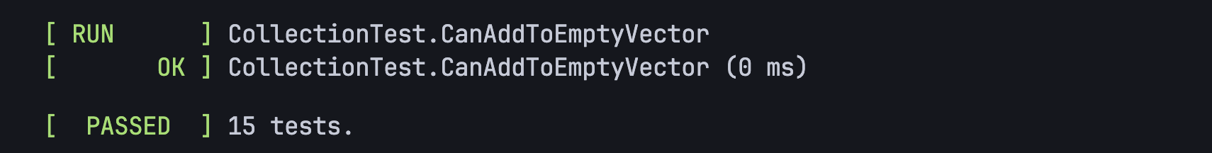
Does adding one value to an empty collection make its size 1?
TEST_F(CollectionTest, CanAddToEmptyVector)
{
ASSERT_TRUE(collection->empty());
ASSERT_EQ(collection->size(), 0);
add_entries(1);
EXPECT_FALSE(collection->empty());
EXPECT_EQ(collection->size(), 1);
}
Positive test
What it proves
Proves the collection starts empty and grows by exactly one
Taking it a step further
Turn it into a parameterized test that checks many sizes at once
Run it under AddressSanitizer to catch hidden memory errors

Slide 11
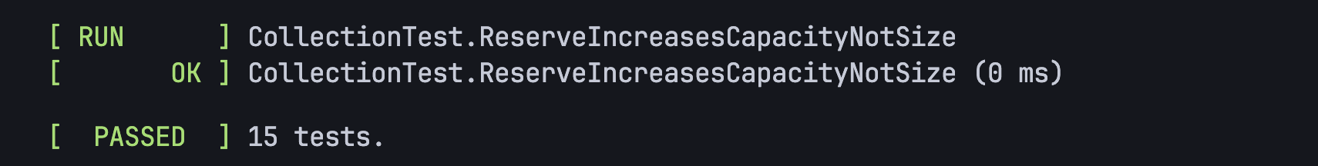
Does reserve increase capacity without changing size?
TEST_F(CollectionTest, ReserveIncreasesCapacityNotSize)
{
add_entries(5);
ASSERT_EQ(collection->size(), 5);
collection->reserve(100);
EXPECT_GE(collection->capacity(), 100);
EXPECT_EQ(collection->size(), 5);
}
Positive test
What it proves
Proves reserve only sets aside room and never adds fake elements
Taking it a step further
Add a negative case that reserves past max_size
Check that the existing values are unchanged after the reserve

Slide 12
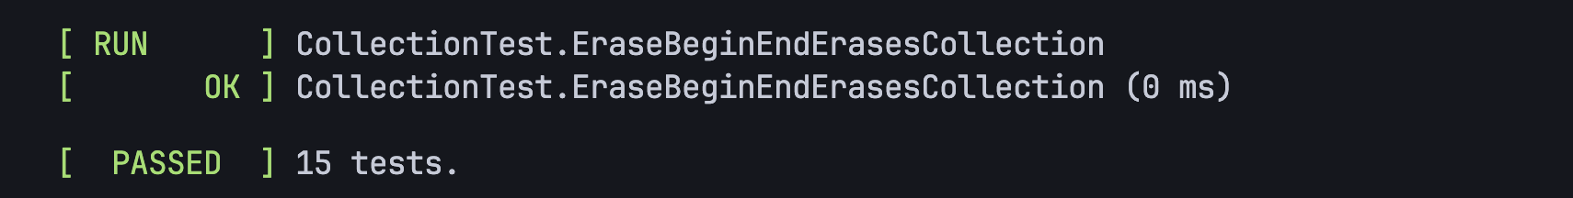
Does erase(begin, end) empty the whole collection?
TEST_F(CollectionTest, EraseBeginEndErasesCollection)
{
add_entries(10);
ASSERT_EQ(collection->size(), 10);
collection->erase(collection->begin(),
collection->end());
EXPECT_EQ(collection->size(), 0);
EXPECT_TRUE(collection->empty());
}
Positive test
What it proves
Proves erasing the full range leaves nothing behind
Taking it a step further
Erase a partial range and check the leftover values
Run it under AddressSanitizer to prove nothing touches freed memory

Slide 13
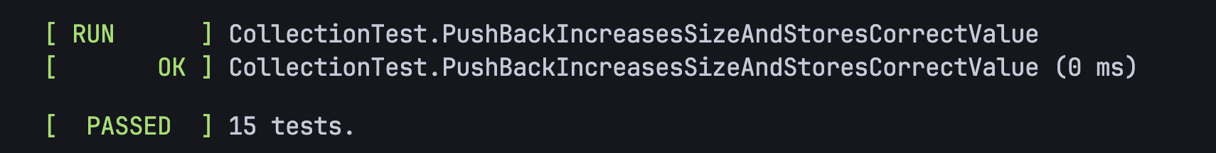
Does push_back store the exact value it was given?
TEST_F(CollectionTest,
PushBackIncreasesSizeAndStoresCorrectValue)
{
collection->push_back(42);
EXPECT_EQ(collection->size(), 1);
EXPECT_EQ(collection->at(0), 42);
}
Positive test
What it proves
Proves the value lands in the right spot and not just that the size grew
Taking it a step further
Push many values in a loop and check every one stays in order
Use at() instead of [ ] in checks so a bad index throws

Slide 14
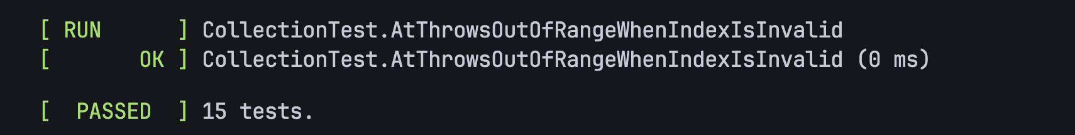
Does at() throw out_of_range for an invalid index?
TEST_F(CollectionTest,
AtThrowsOutOfRangeWhenIndexIsInvalid)
{
EXPECT_THROW(collection->at(1),
std::out_of_range);
}
Negative test
What it proves
Proves a bad index throws instead of reading memory it doesntt own
Taking it a step further
Also test an index equal to size, the classic off by one
Fuzz the index with random values to cover more cases

Slide 15
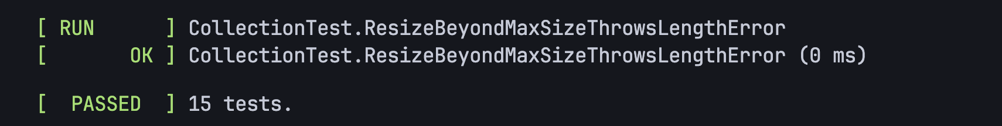
Does resizing past max_size throw length_error?
TEST_F(CollectionTest,
ResizeBeyondMaxSizeThrowsLengthError)
{
EXPECT_THROW(collection->resize(
collection->max_size() + 1),
std::length_error);
}
Negative test
What it proves
Proves an impossible size request fails safely instead of corrupting memory
Taking it a step further
Check the collection is unchanged after the failed resize
Add the same kind of negative test for reserve

Slide 16

AUTOMATION SUMMARY
Where security runs
Design: IDE plug-ins
Build: compiler warnings treated as errors
Verify and test: static analysis, sanitizers, unit tests
Transition: signed builds, pen testing
Monitor and respond: SIEM, intrusion detection, WAF

Slide 17
TOOLS
Every stage of the DevSecOps loop gets its own automated check and access to the pipeline runs through Active Directory and LDAP
Stage | Tools | Standards it enforces
Assess and plan | Risk levels from this policy, threat modeling | Level 5 standards get fixed first
Design | SonarLint and Clang-Tidy IDE plug-ins | STD-001, STD-006, STD-007
Build (compiler) | Clang with -Wall, -Wextra, -Wconversion as errors | STD-001, STD-002, STD-006
Verify and test | Cppcheck, Clang Static Analyzer, SonarQube, Google Test with sanitizers | STD-003, STD-005, STD-007 to STD-010
Transition and health check | Only signed builds deploy, pen test before major releases | All standards
Monitor, detect and respond | SIEM, intrusion detection, WAF, rollback | STD-004 at runtime

Slide 18
RISKS AND BENEFITS
Problem: our data was unencrypted and security habits were never standardized.
Solution: adopt this policy and automate it in the pipeline.
If we act now
Benefit: bugs get caught when they're cheapest to fix
Benefit: every build proves compliance for the audit
Risk: up front time, a learning curve, and false positives that slow builds
If we wait
Risk: breaches like Capital One and Equifax started with known weaknesses
Risk: every new feature adds more code to fix later
Only benefit: faster short term delivery, which doesn't outweigh a breach
Where it's lacking: tools miss logic bugs
Steps: fix Level 5 first, run tools in warning mode, then enforce…

Slide 19
RECOMMENDATIONS
Cloud and server configuration
No standard covers how servers and firewalls get configured
Real world example
Capital One 2019: a misconfigured web application firewall allowed an SSRF attack that exposed 106 million customers (Neto et al., 2020)
API abuse and data scraping
No standard limits how much data an API hands out or how fast
Real world example
LinkedIn 2021: scraping through APIs put data tied to about 700 million users up for sale (Leyden et al., 2025)
Third party and outdated code
No standard for tracking and patching libraries and frameworks
Real world example
Equifax 2017: a website application vulnerability exposed over 145 million Americans (Norton, 2019)

Slide 20
CONCLUSIONS
Secure configuration standard
Review firewall and cloud permissions on every change, and give cloud roles least privilege so an SSRF can't reach sensitive data
API security standard
Authenticate every call, rate limit requests, and return only the data each caller really needs
Dependency management standard
Scan third party code on every build and set patch deadlines based on severity
Concurrency standard
Add SEI CERT concurrency (CON) rules as Green Pace's apps grow more multithreaded
Moving forward, I'd review this policy every year and after any incident, so the standards keep up with new threats.

Slide 21
WORKS CITED
Google. (n.d.). GoogleTest primer. GitHub. https://github.com/google/googletest/blob/main/docs/primer.md
Leyden, J., Swinhoe, D., & Hill, M. (2025, June 12). The 20 biggest data breaches of the 21st century. CSO Online. https://https://www.csoonline.com/article/534628/the-biggest-data-breaches-of-the-21st-century.html
Neto, N. N., Madnick, S., de Paula, A. M. G., & Borges, N. M. (2020). A case study of the Capital One data breach (Working Paper CISL# 2020-07). MIT Sloan School of Management. https://cams.mit.edu/wp-content/uploads/capitalonedatapaper.pdf
Norton. (2019, September 5). What is a security breach? https://us.norton.com/blog/privacy/security-breach
Software Engineering Institute. (n.d.). SEI CERT C coding standard. Carnegie Mellon University.https://www.sei.cmu.edu/library/sei-cert-c-and-c-coding-standards/
Software Engineering Institute. (n.d.). SEI CERT C++ coding standard. Carnegie Mellon University. https://www.sei.cmu.edu/library/sei-cert-c-and-c-coding-standards/
SonarSource. (n.d.). C++ static code analysis. Sonar. https://www.sonarsource.com/knowledge/languages/cpp/

